Slide 1
What is agile?

Slide 2
What is agile?
Let’s first learn what agile is not.
Agile is NOT a methodology
Agile is NOT a specific way of developing software
Agile is NOT a framework or process
Agile is a set of values and principles.
It is the collection of beliefs that allow a team to make decisions on developing software.
Waterfall vs Agile

Slide 3
What is agile?
Agile Software Development Process Model: link 1
Agile Software Development Process Model: link 2
Agile Software Development Process Model: link 3

Slide 4
What is agile?
Agile is surprisingly flexible. It gives teams a foundation for making best decisions in their case.
Agile tend to value -
Individuals and interactions over processes and tools
Working software over comprehensive documentation
Customer collaboration over contract negotiation
Responding to change over following a plan

Slide 5
What is agile?
In addition to the values, there are 12 principles that support the values.
Our highest priority is to satisfy the customers through early and continuous delivery of valuable software
Welcome changing the requirements, even late in development. Agile processes harness change for the customer’s competitive advantage.
Deliver working software frequently, from a couple of weeks to a couple of months, with a preference for the shorter timescale.

Slide 6
What is agile?
Business people and developers must work together daily throughout the project.
Build projects around motivated individuals. Give them the environment and support they need and trust them to get the job done.
The most efficient and effective method of conveying information to and within a development team is face-to-face conversation.
Working software is the primary measure of progress.

Slide 7
What is agile?
Agile processes promote sustainable development. The sponsors, developers, and users should be able to maintain a constant pace indefinitely.
Continuous attention to technical excellence and good design enhances agility.
Simplicity, the art of maximizing the amount of work not done, is essential.
The best architectures, requirements, and designs emerge from self-organizing teams.
At regular intervals, the team reflects on how to become more effective, then tunes and adjusts its behavior accordingly.

Slide 8
What is agile?
Agile’s real utility is giving people a common foundation for making decisions about the best way to develop a software. For example -
A client clearly stating and signing his requirements before starting a project violates the following agile principles
Prioritize customer collaboration over contract negotiation
Work with customers everyday

Slide 9
What is agile?
In another case, a developer might figure out that the software that he is working on needs support form database.
He may want to pause his work on the software to build a robust database layer that will benefit this project and also future projects.
But if he is following the agile principles and values, he will see this as having to delay what the customer will find as valuable software that they can use.
If he finds a way to build just what is necessary to deliver this feature, it will better align with all the principles.

Slide 10
What is agile?
An agile team will be making hundreds of such decisions each week.
That is what it means to be agile - making each decision based on the principles and values that the team has decided to follow.
But be careful to not simple copy the actions of a team. What works for another team may not work for yours.
Hence is it important to understand why a team follow certain practices rather than following the practices blindly.
In fact, a good agile team would probably be changing their practices with time.

Slide 11
XP

Slide 12
What is Extreme Programming (XP)?
Click here to see a video on XP.
Click here to see another video on XP.
An agile development methodology
Created by Kent Beck in the mid 1990’s
A set of 12 key practices taken to their “extremes”
A mindset for developers and customers
A religion?

Slide 13
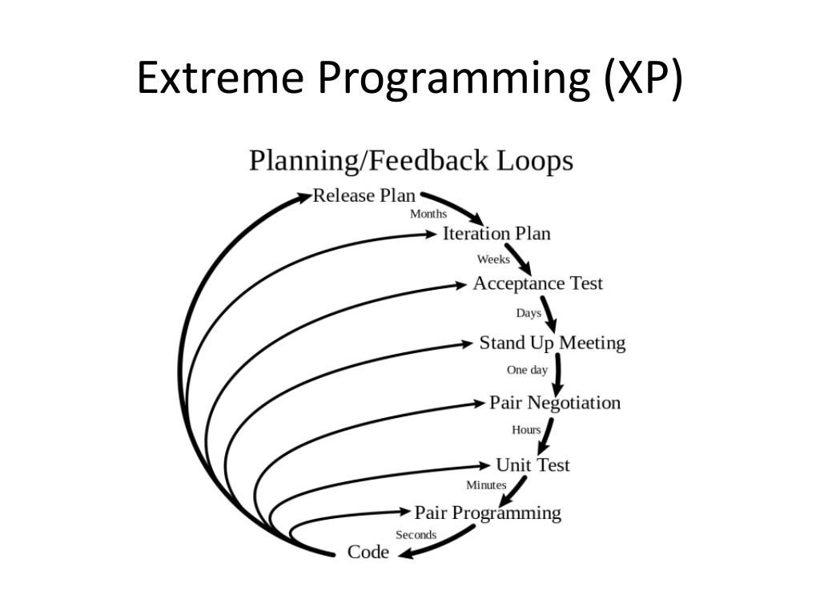

Slide 14
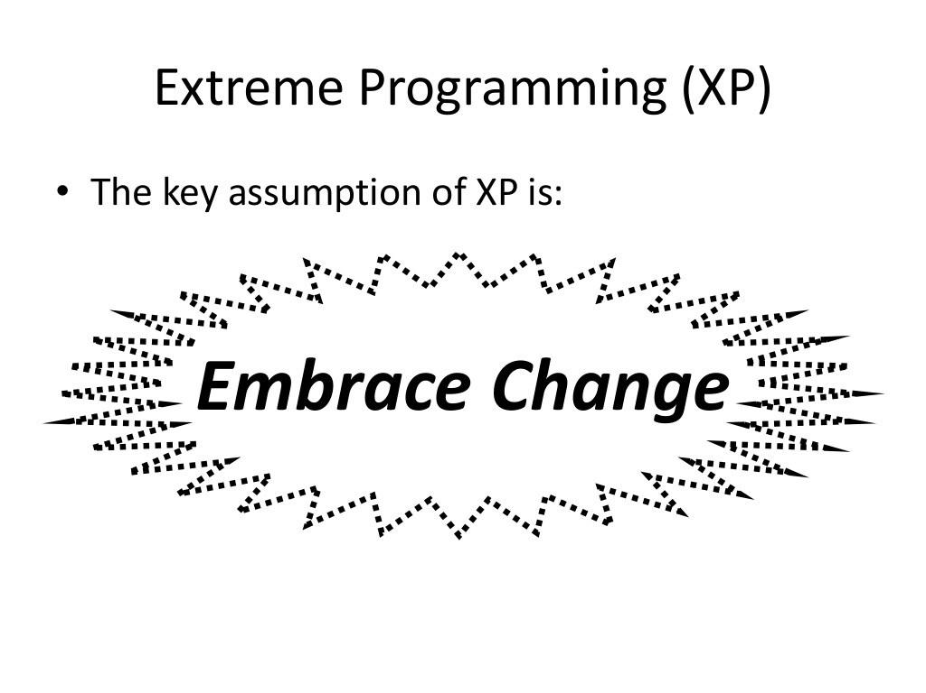

Slide 15
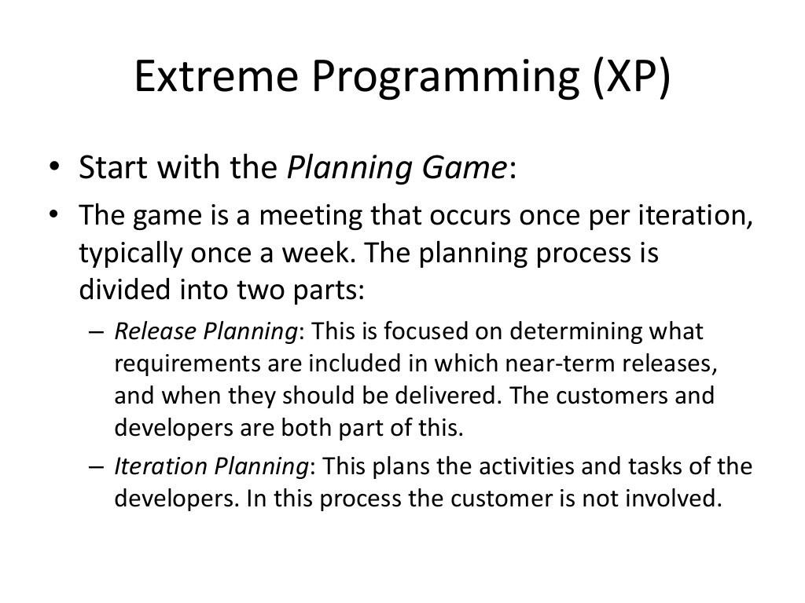

Slide 16
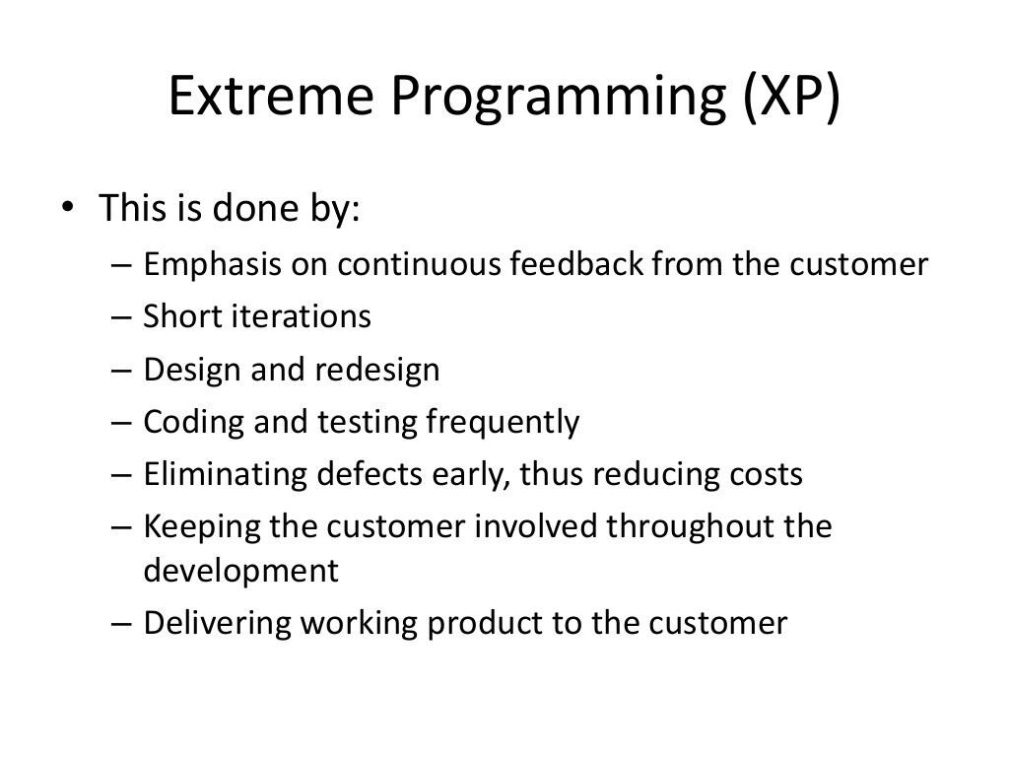

Slide 17
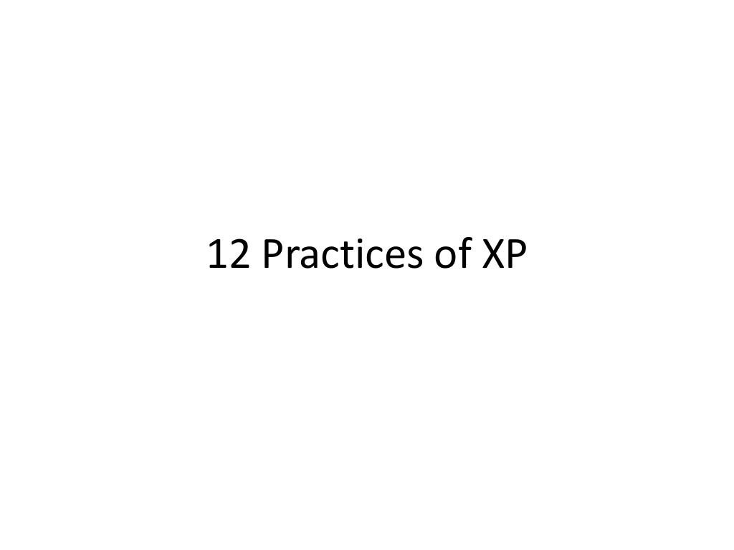

Slide 18
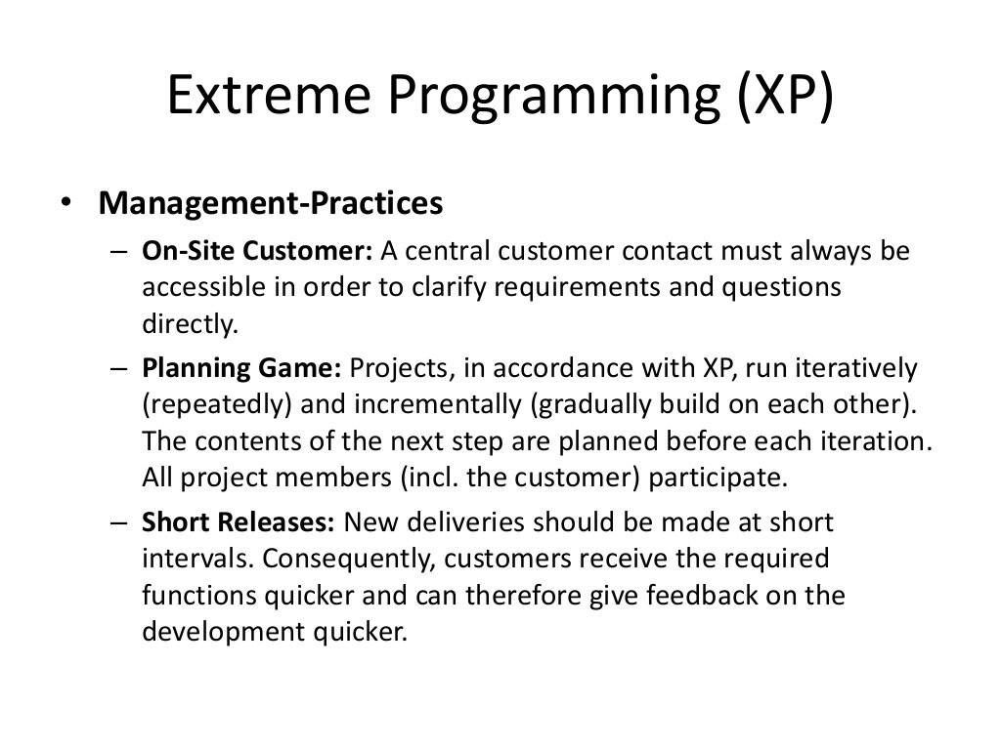

Slide 19
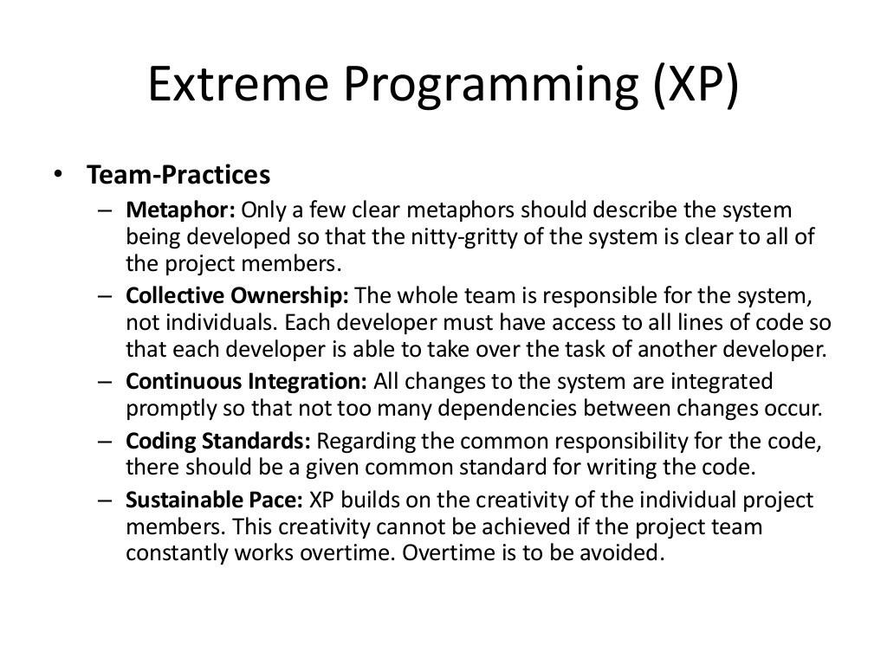

Slide 20
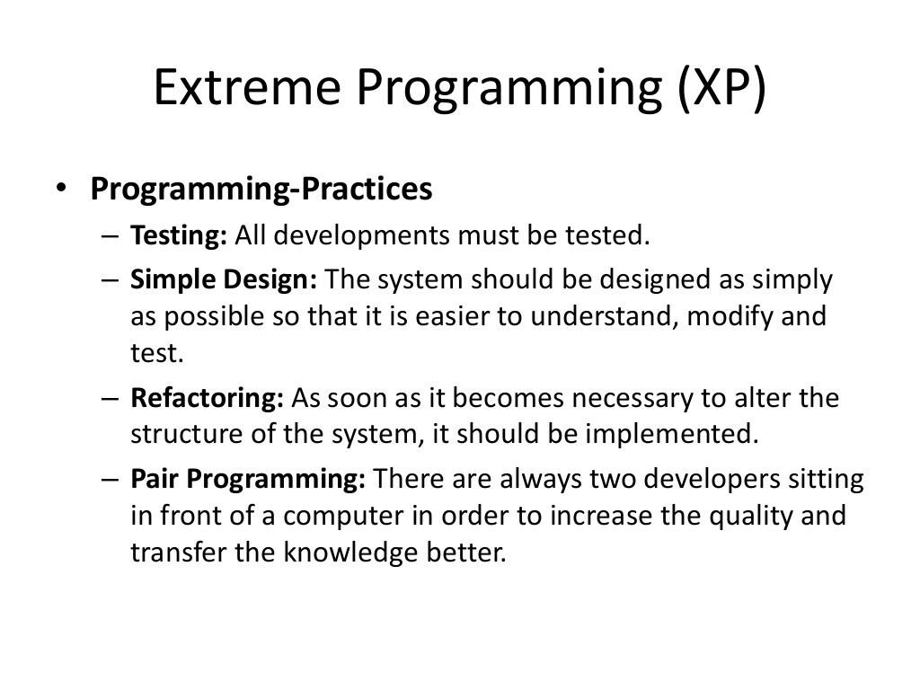

Slide 21
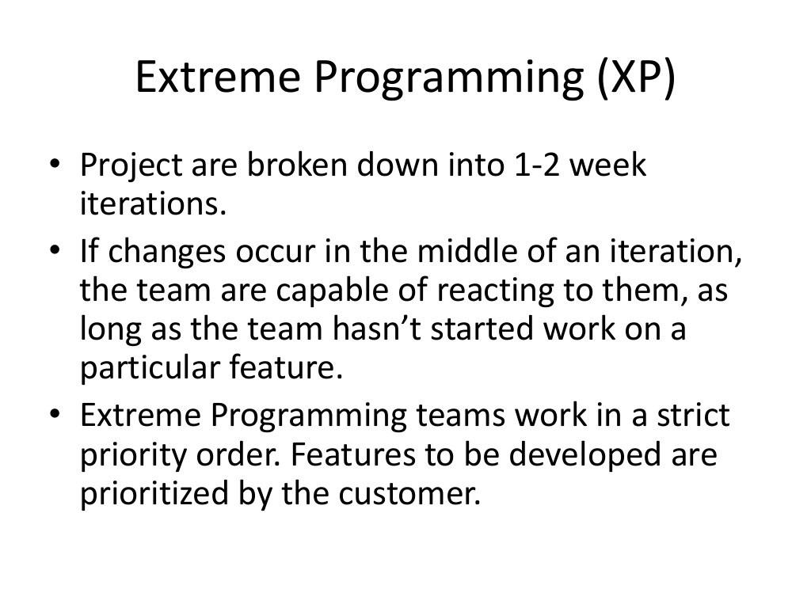

Slide 22
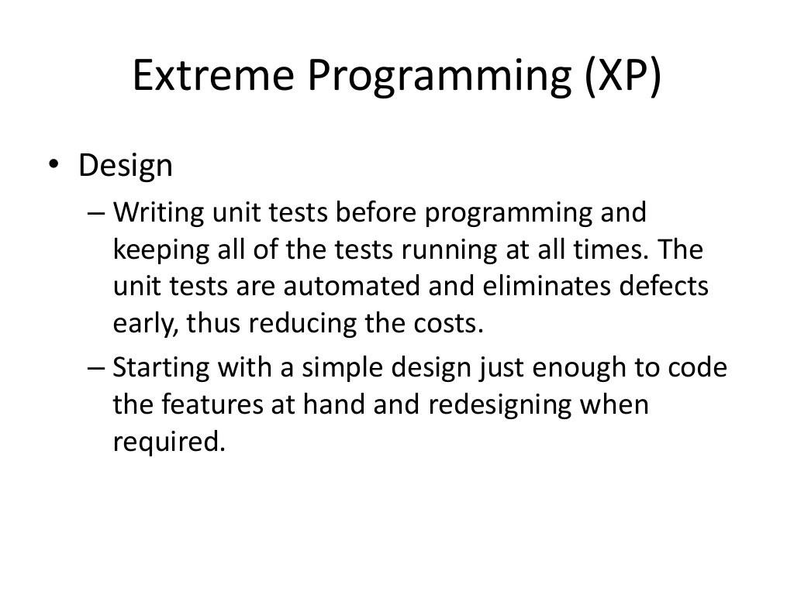

Slide 23
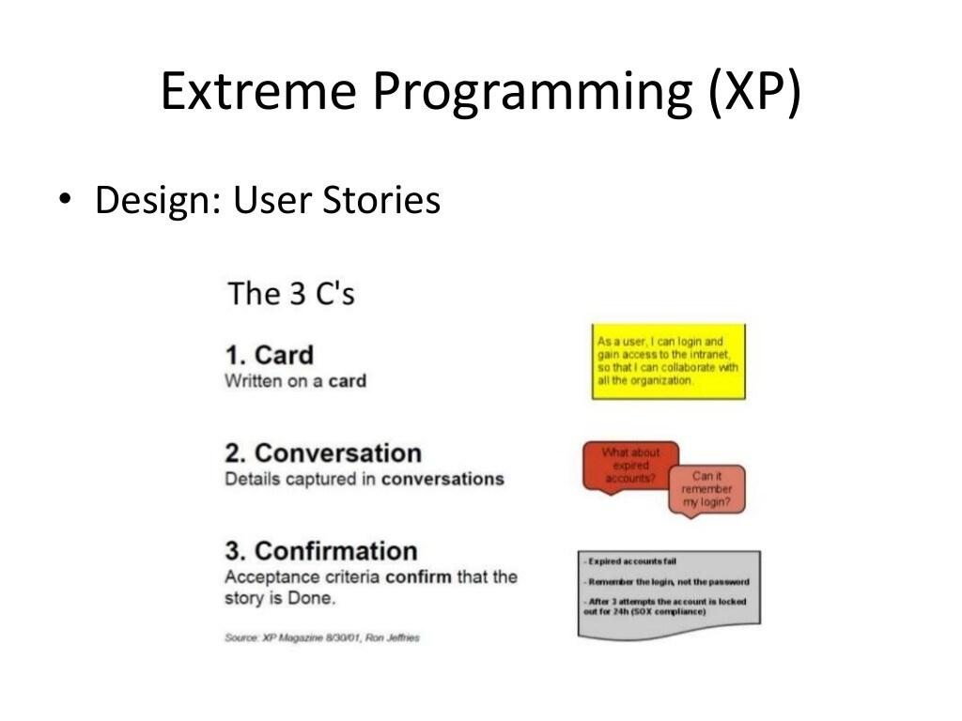

Slide 24
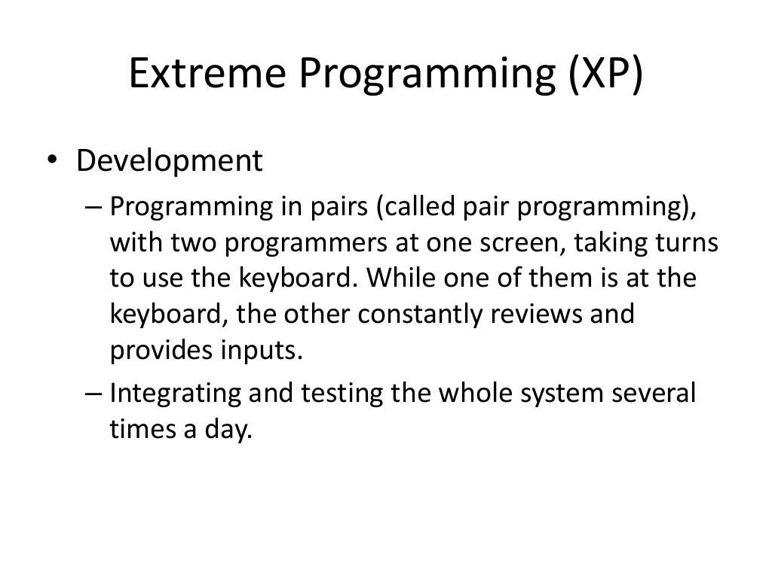

Slide 25
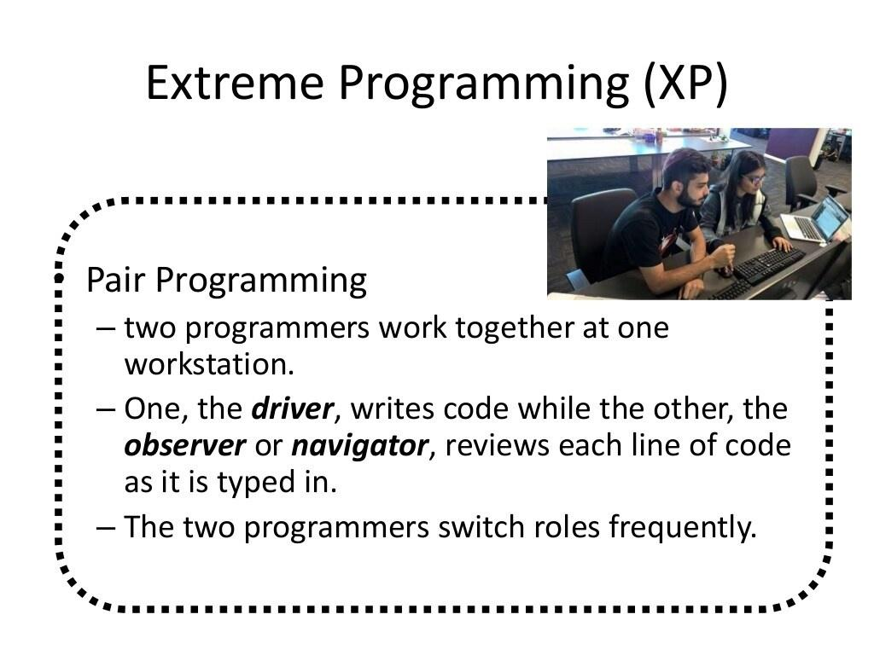

Slide 26
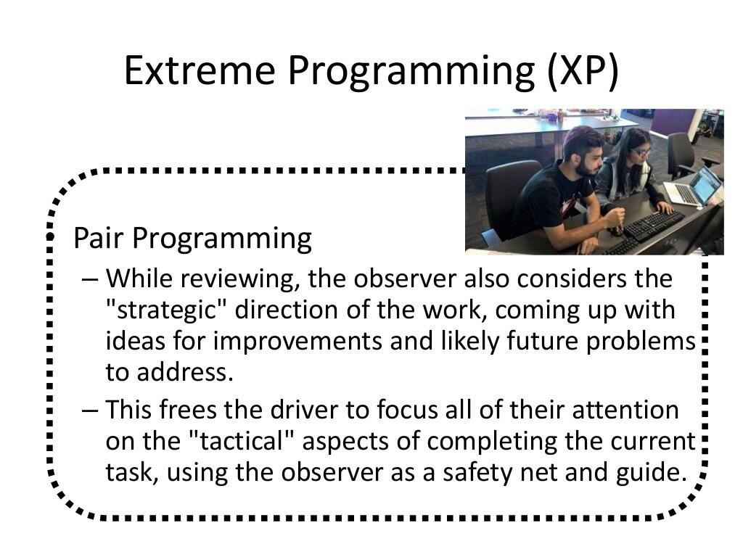

Slide 27
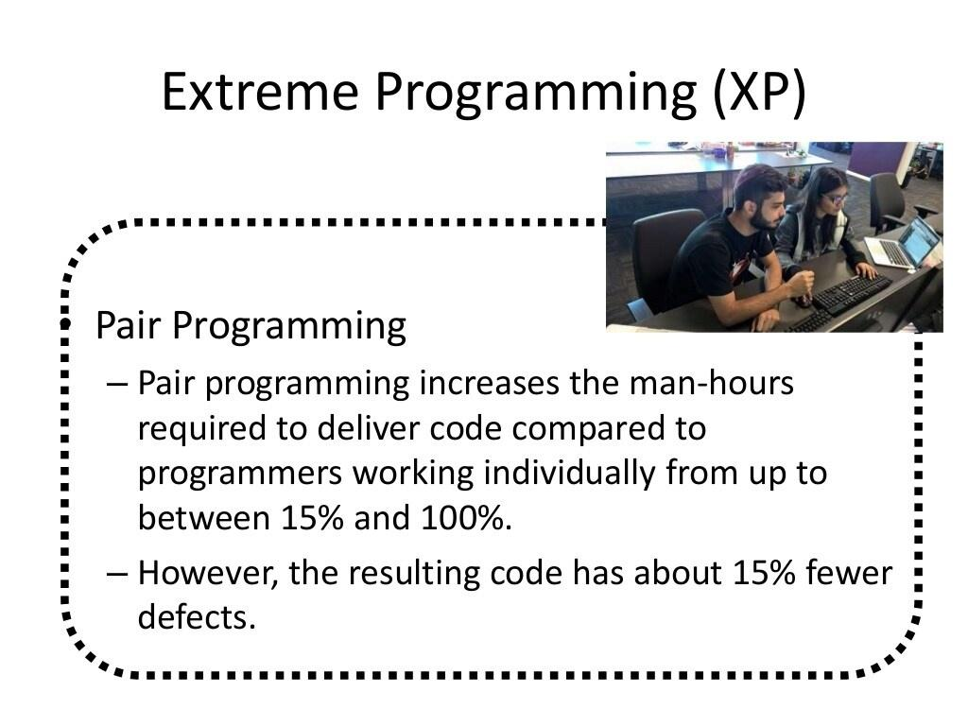

Slide 28
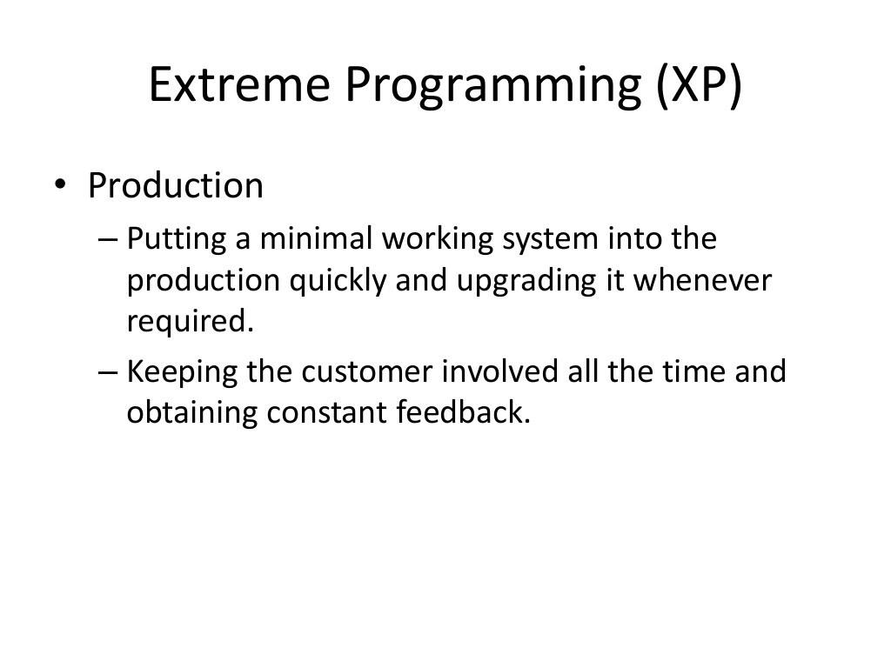

Slide 29
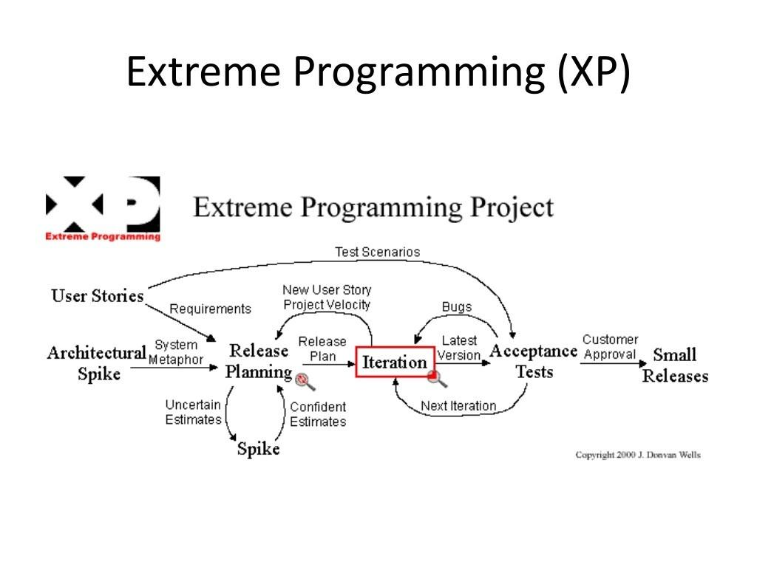

Slide 30
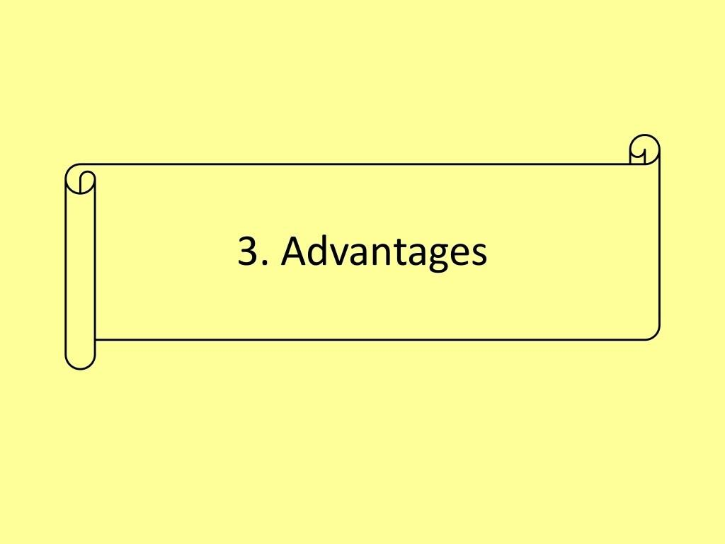

Slide 31
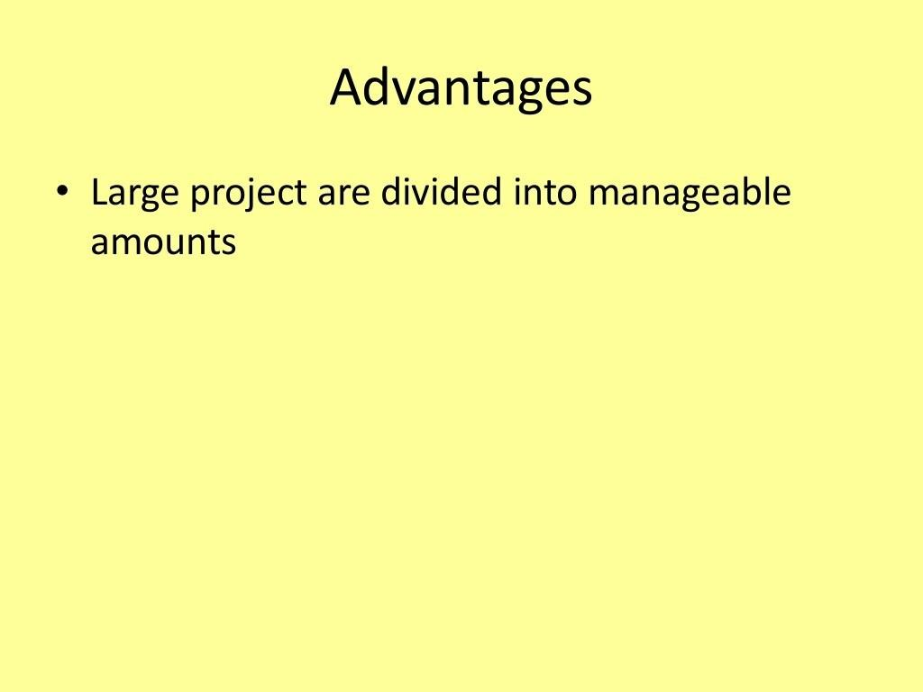

Slide 32
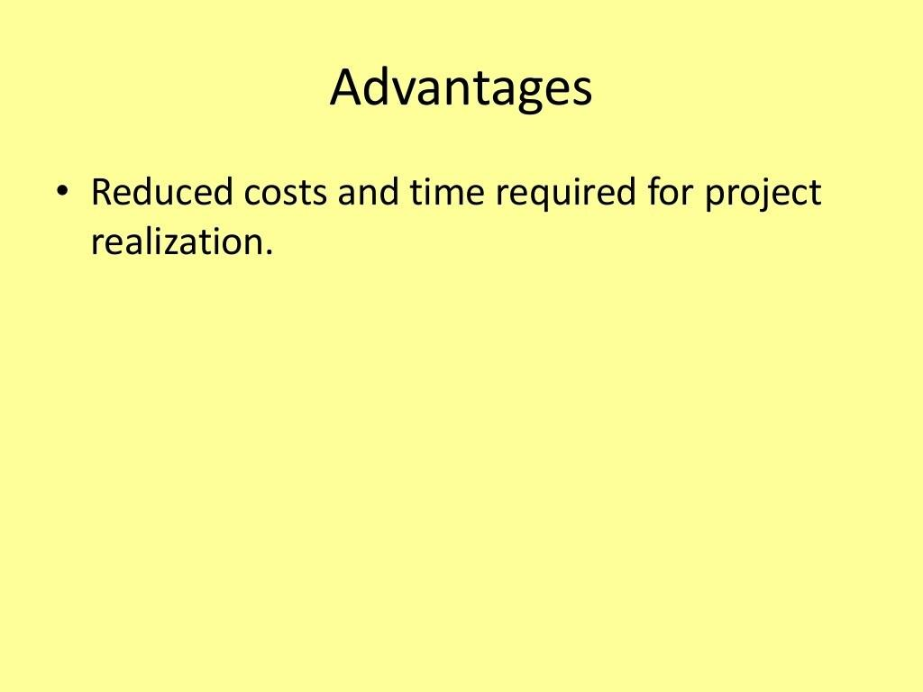

Slide 33
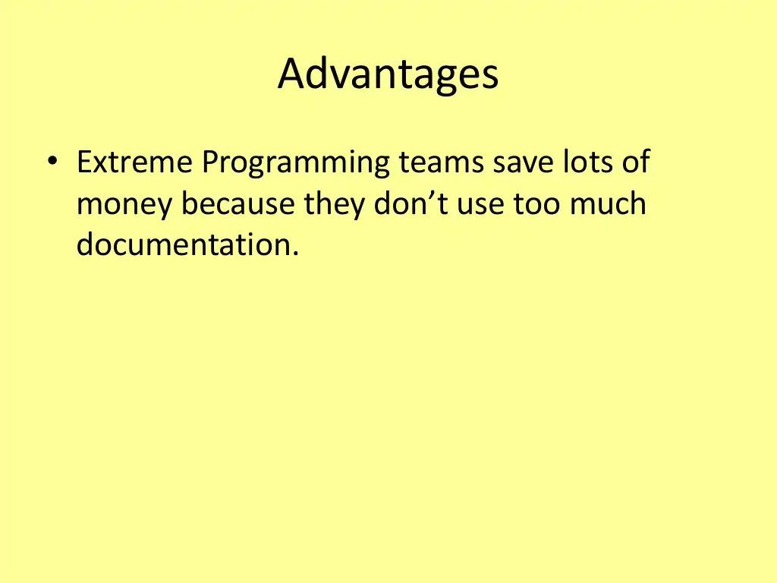

Slide 34
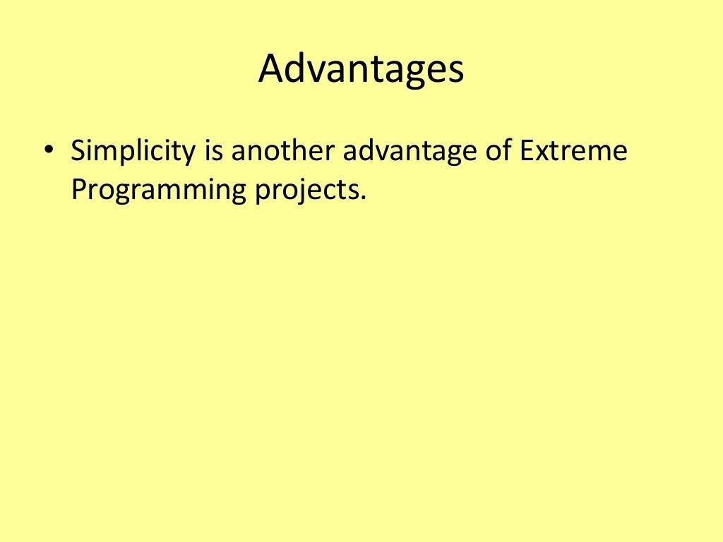

Slide 35
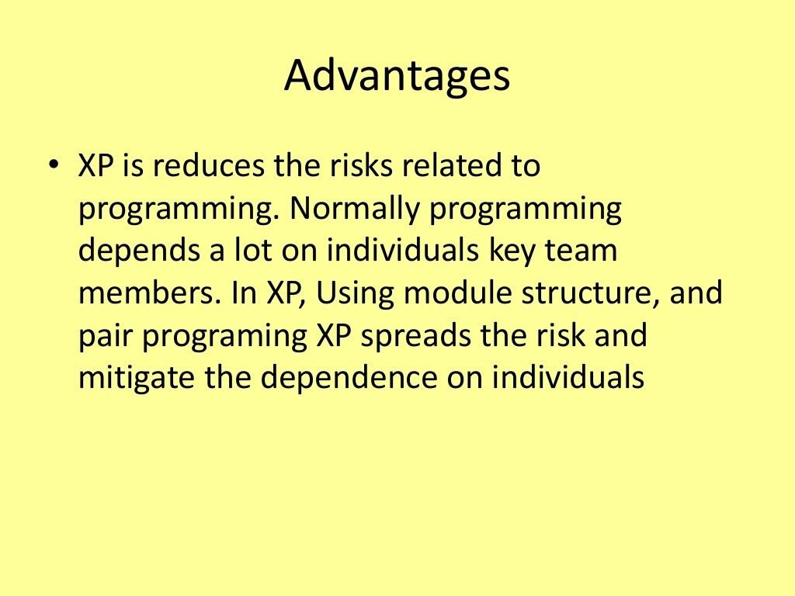

Slide 36
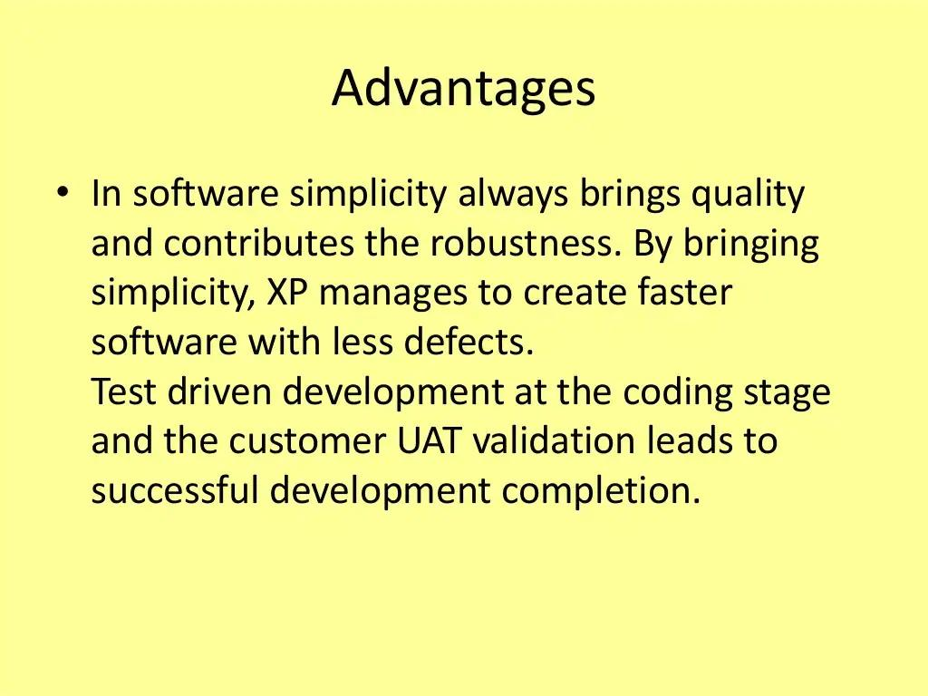

Slide 37
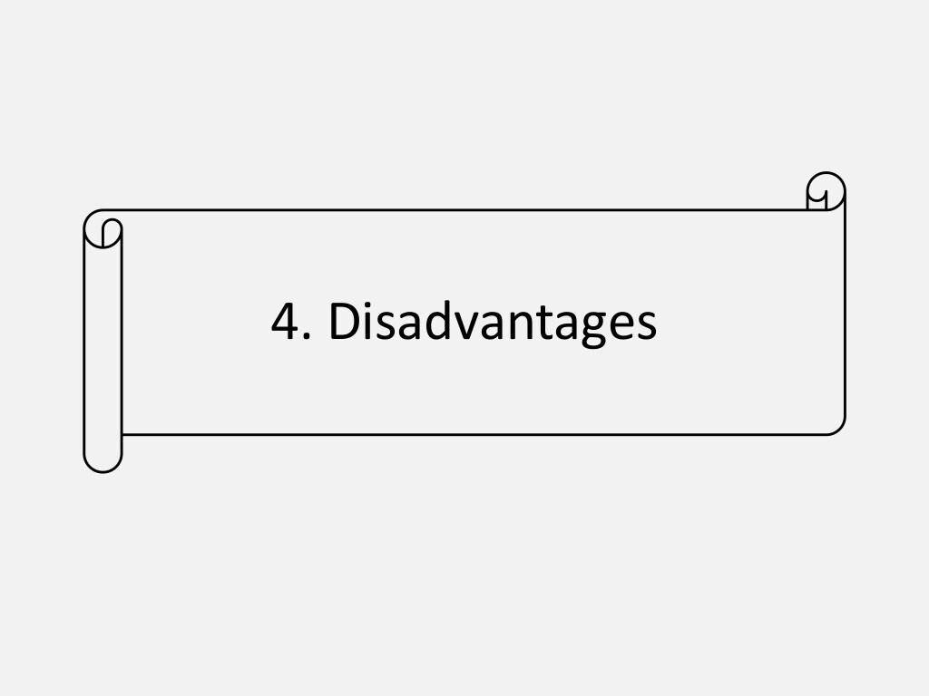

Slide 38
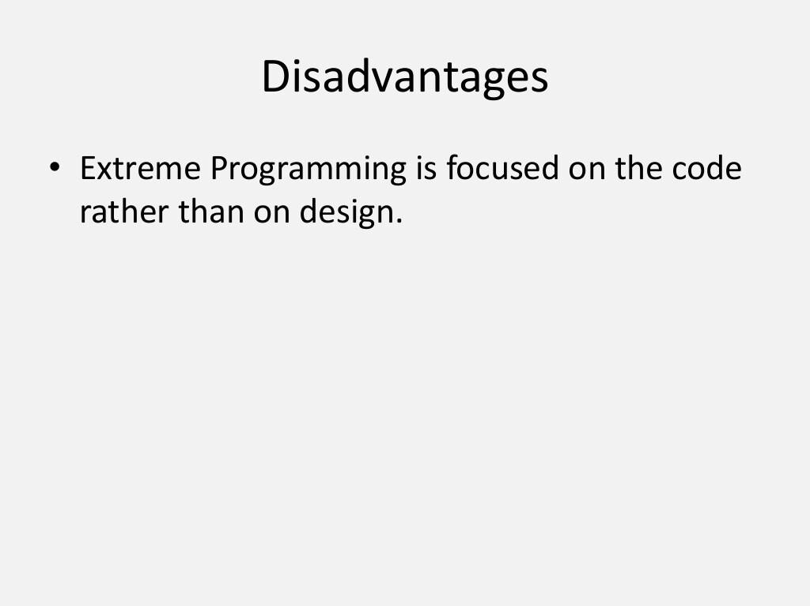

Slide 39
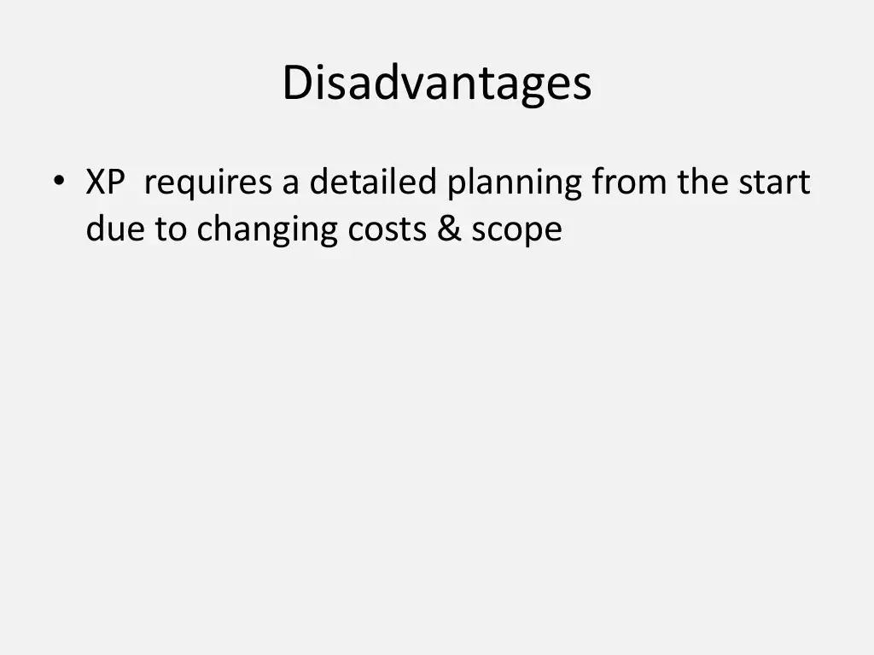

Slide 40
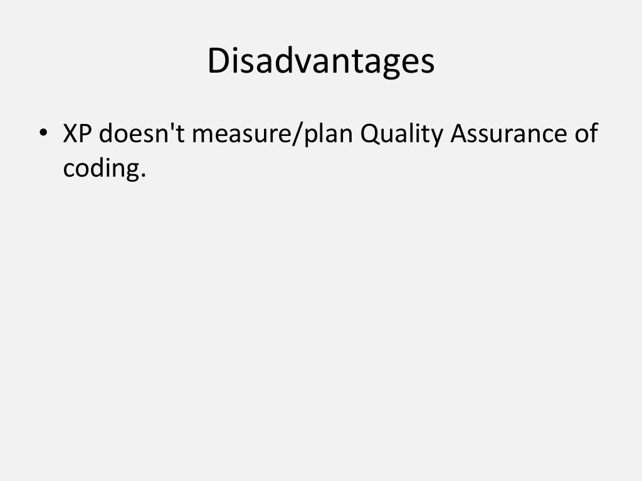

Slide 41
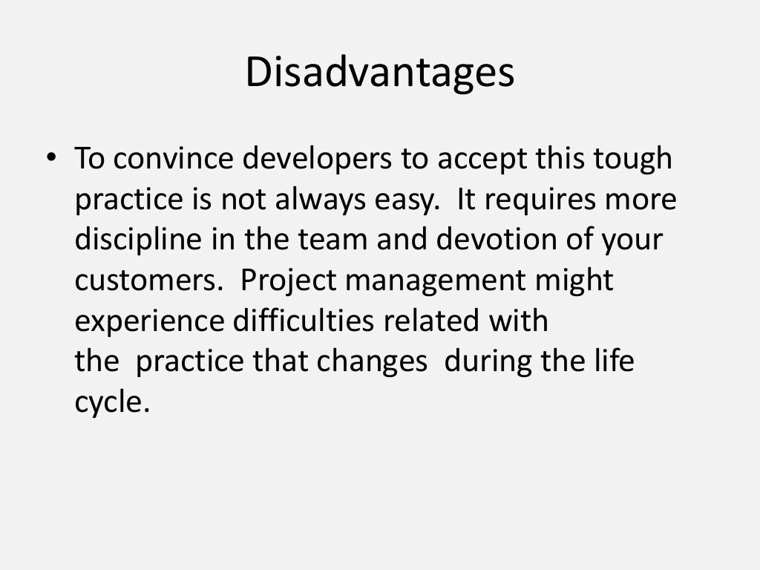

Slide 42
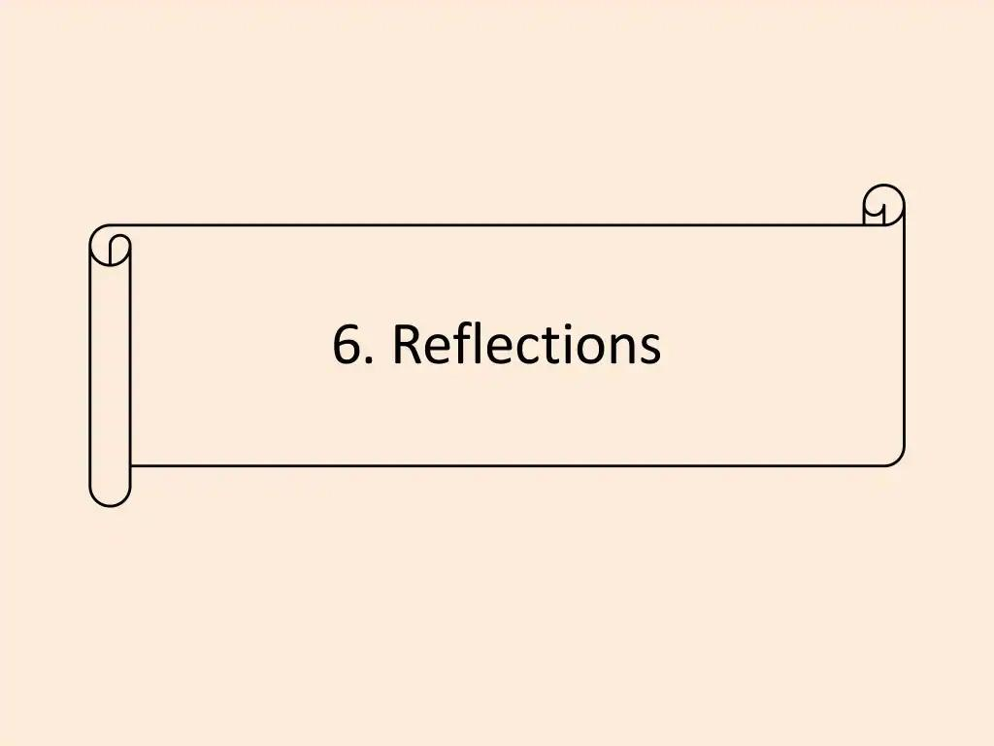

Slide 43
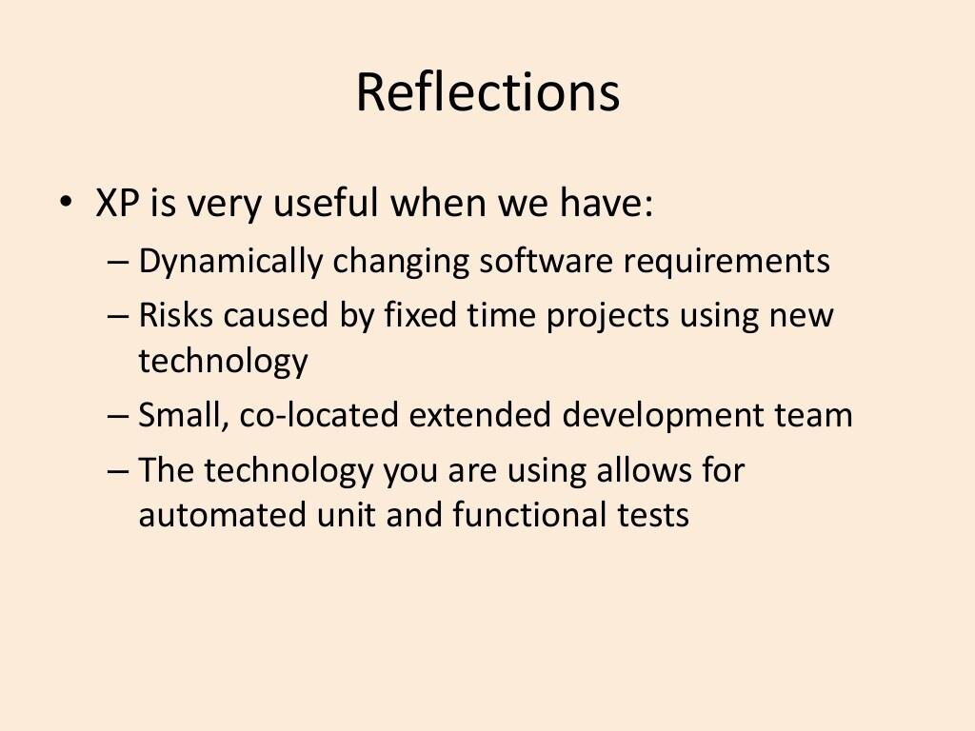

Slide 44
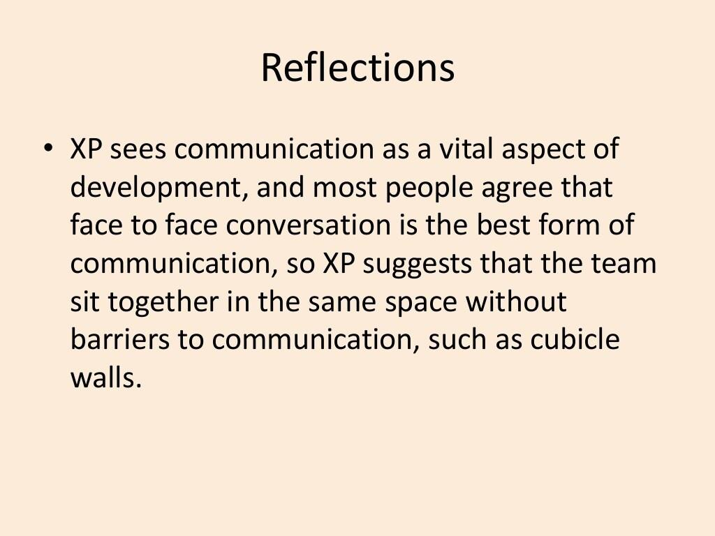

Slide 45
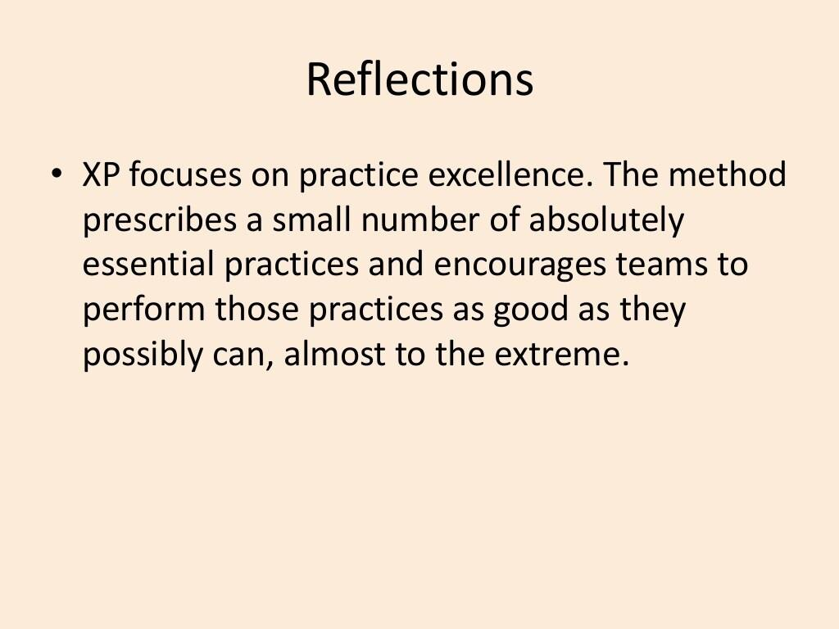

Slide 46
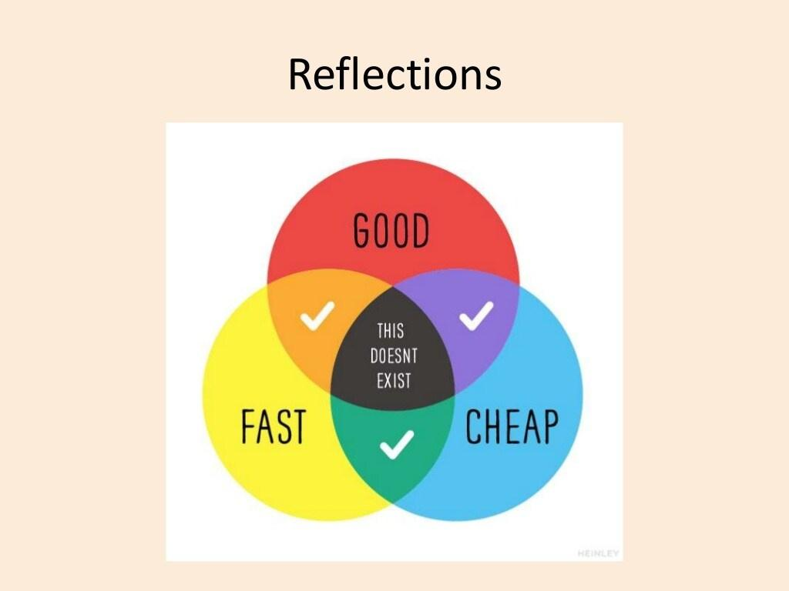

Slide 47
Classwork

Slide 48
Classwork
In your own words, describe what you understand by agile.
“I follow the Agile methodology. I find it very easy. It is a well-defined collection of steps and decisions that I simply need to follow. There is not much social interaction or thinking needed from my side except for the coding.” How many mistakes can you find in that? Correct the mistakes.
What are the 12 principles of agile?
“Lines of code is a valid measure progress since we, the developers, are spending time and resources to write it.” Do you agree? What does agile principles tell you about this?
Some people think that maximizing the amount of work not done is cheating. What do you think about this?

Slide 49
Classwork
Describe extreme programming in your own words.
Is extreme programming the same thing as Agile?
What are the practices of extreme programming? Are they the same as the principles of agile?
Do you think that a team following extreme programming are agile by default? Or is it possible to follow extreme programming without being agile?
Is XP an iterative model?
Why are user stories important in XP?
What is your view on pair programming? Do you think it is useful, or is it a waste of man hours?

Slide 50
Thank you!

